Slide 1
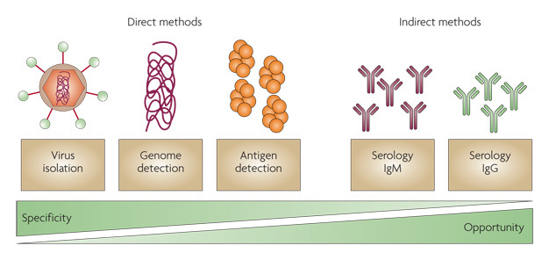
Diagnostic method in virology
Dr. CHHAY Sokdalis

Slide 2
Objective
After this session the students should be able to:
Demonstrate the important of diagnosis in virology
Categorize the samples for diagnosis of viral infections
Identify the laboratory procedure for diagnosis in virology
Interpret the usage of electron microscope to identify virus in medical laboratory.
Explain the cell culture to identify virus in medical laboratory.
Describe the techniques that detect viral protein to identify virus in medical laboratory.
Illustrate the principle of ELISA technique
Illustrate the principle of PCR polymerase chain reaction.
Describe the serology techniques of direct detection antigen and antibody of virus

Slide 3
Plan
Introduction
Nature, collection and transport of sample
Direct diagnosis technique
Indirect diagnostic technique

Slide 4
Introduction
New developments in laboratory viral diagnosis →more rapid and sensitive viral identification from clinical samples (Ab reagents, molecular genetics techniques and genomic sequencing…).
Quicker turnaround → more rapid choice of appropriate antiviral therapy.
Viral laboratory studies are performed to:
confirm diagnosis by identifying viral agent of infection,
determine appropriate antiviral therapy,
check on compliance of patient taking antiviral drugs,
define course of disease,
monitor disease epidemiologically,
educate physicians and patients.

Slide 5
Introduction
Laboratory methods accomplish following results:
Description of virus-induced cytopathologic effects (CPEs) on cells.
Detection of viral particles
Isolation and growth of virus
Detection and analysis of viral components (e.g., proteins (antigens), enzymes, genomes).
Evaluation of patient’s immune response to virus (serology).

Slide 6
SPECIMEN COLLECTION
Selection of appropriate specimen for analysis is often complicated because several viruses may cause same clinical disease.
Specimens: collected early in acute phase of infection, before virus ceases to be shed.
Ab produced in response to infection may block detection of virus.
Transport and store: on ice and in special media that contain antibiotics and proteins (serum albumin or gelatin).

Slide 7
SPECIMEN COLLECTION
Principal interest in virology samples:
Anticoagulated whole blood (EDTA > preferred heparin) - Travel time: <5-6 H
CSF - Travel time: <1 H - Sufficient volume to desired test (difficult for sampling many times)
Stools - Virus stored at 4ºC + several days in transport media.
Urine - Travel time: <2-3 H - Volume: 15-20 ml
Vesicles and ulceration mucocutaneous - Careful sampling - Small swab or needle seryngue (in case high in fluid injury)
Tissue fragment - Add a few milliliter of saline - Formalin fixation (Bouin): in situ study
Composition of Bouin (cyto-hystologique study) 1. Saturated picric acid in 75% aqueous solution 2. Formalin (formaldehyde solution 37%) 20% 3. Glacial acetic acid 5%

Slide 8
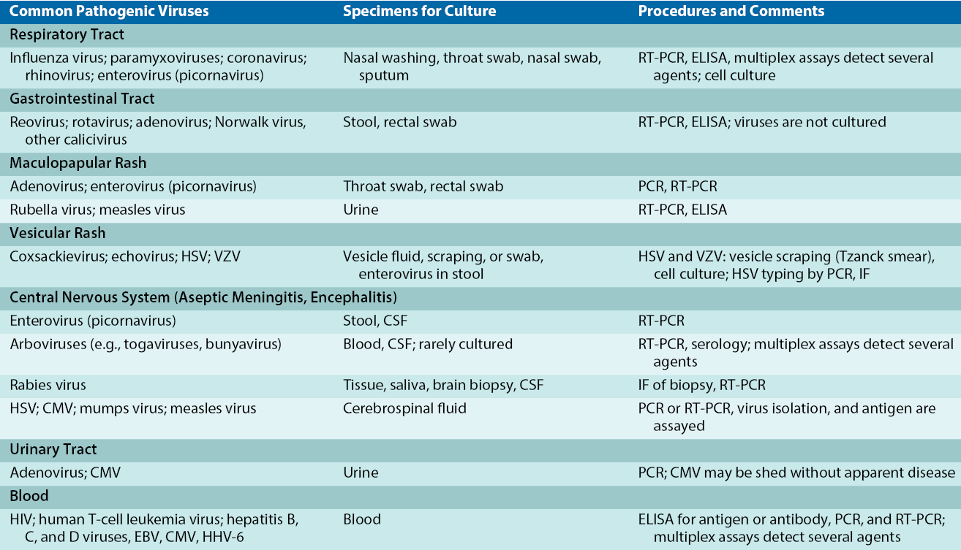
SPECIMEN COLLECTION

Slide 9
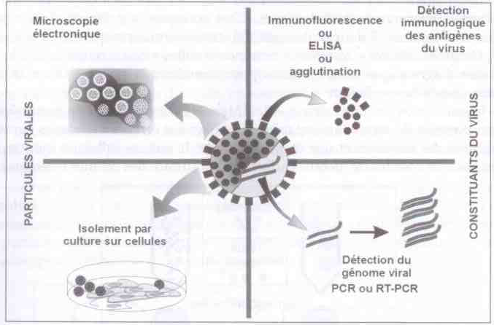
Diagnosis technique
Presentation of 4 groups of diagnostic techniques in virology

Slide 10
Diagnosis technique
Laboratory Procedures for Diagnosing Viral Infections:
Cytologic examination
Electron microscopy
Virus isolation and growth (culture)
Detection of viral proteins (Ag and enzymes)
Detection of viral genomes (DNA or RNA)
Serology (Ag and Ab)

Slide 11
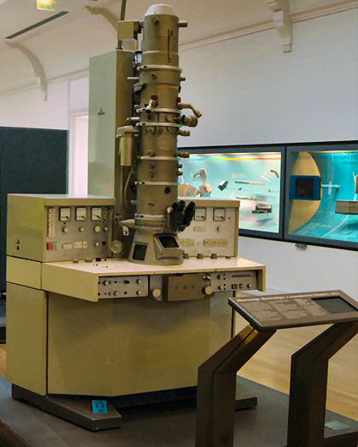
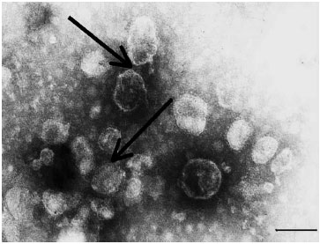
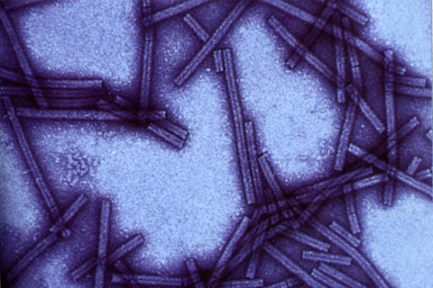
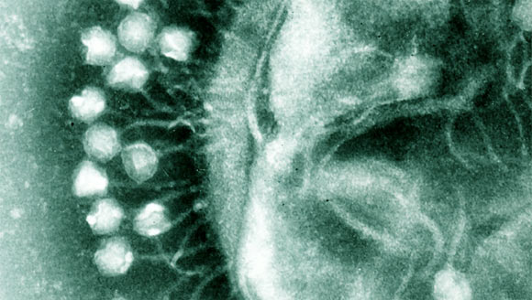
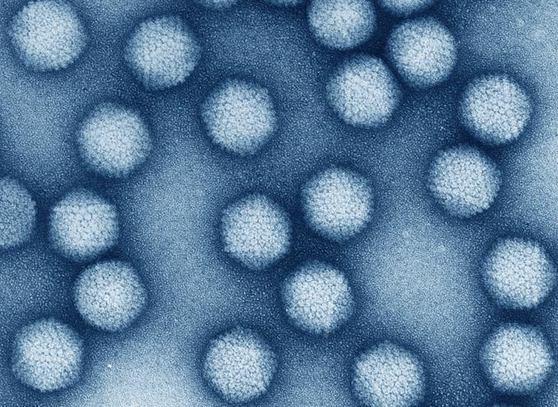
Electron microscopy
Not a standard clinical laboratory technique, detect and identify some viruses if sufficient viral particles are present.
After (-) staining → direct visualization of virus in large quantities in sample.
Very useful for non-culturable virus: Rotavirus, Calicivirus, Astrovirus …
↑ sensitivity + serum directed against virus (immunoelectron microscopy).
Differentiate: chickenpox and smallpox.
Unable to differentiate 2 viruses in same family.

Slide 12
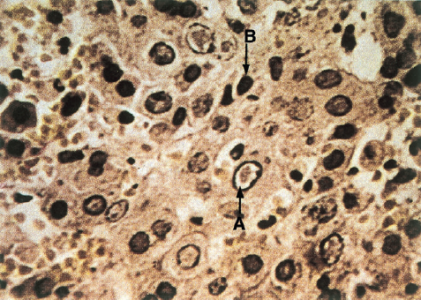
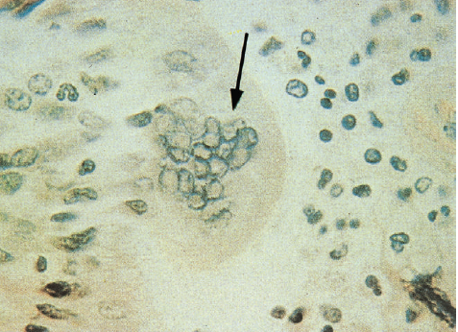
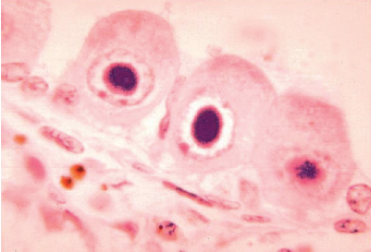
Cell Culture
Specific types of tissue culture cells are used to grow viruses:
Primary cell cultures
Secondary cell cultures
Diploid cell lines
Tumor cell lines and immortalized cell lines.
Many viruses produce a characteristic CPE in tissue sample or in cell culture (changes in cell morphology, cell lysis, vacuolation, syncytia) and inclusion bodies.

Slide 13
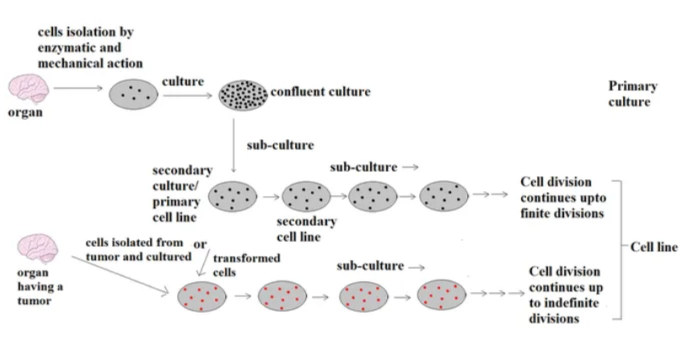

Slide 14
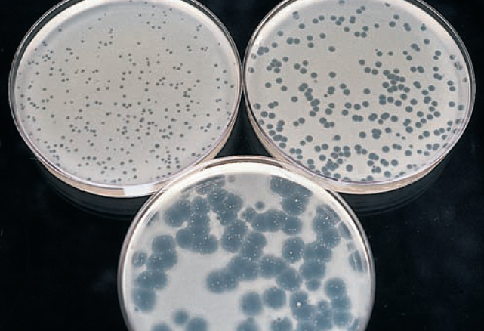
Cell Culture
Viral Detection
Observation of virus-induced CPE: immunofluorescence, or genome analysis of infected cell culture.
Identification: type of cell culture, characteristics of CPE and rapidity of viral growth.
Quantitate a virus by determining greatest dilution (titer):
Tissue culture dose (TCD50): titer of virus that causes cytopathologic effects in half tissue culture cells.
Lethal dose (LD50): titer of virus that kills 50% of a set of test animals.
Infectious dose (ID50): titer of virus that initiates a detectable symptom, Ab, or other response in 50% of a set of test animals.
Number of infectious viruses: evaluated with a count of plaques produced by 10-fold dilutions of sample (plaque-forming units).

Slide 15
DETECTION OF VIRAL PROTEINS
Enzymes and other proteins →detected by biochemical, immunologic, and molecular biology.
Viral proteins →separated by electrophoresis →identify and distinguish different viruses.
Monoclonal or monospecific antibodies →distinguishing viruses (antigens on cell surface or within cell)→detected by immunofluorescence and enzyme immunoassay (EIA).
Virus or antigen released from infected cells→ detected by enzyme-linked immunosorbent assay (ELISA), radioimmunoassay (RIA), and latex agglutination (LA).

Slide 16
DETECTION OF VIRAL PROTEINS
Technique:
Protein patterns (electrophoresis)
Enzyme activities (e.g., reverse transcriptase)
Hemagglutination and hemadsorption
Antigen detection (e.g., direct and indirect immunofluorescence, enzyme-linked immunosorbent assay, Western blot)

Slide 17
DETECTION OF VIRAL GENETIC MATERIAL
Genetic sequence of a virus is a major distinguishing characteristic of family, type, and strain of virus:
Restriction endonuclease cleavage patterns
Size of RNA for segmented RNA viruses (electrophoresis)
DNA genome hybridization in situ (cytochemistry)
Southern, Northern, and dot blots
PCR (DNA)
Reverse transcriptase polymerase chain reaction (RNA)
Real-time quantitative PCR
Branched-chain DNA and related tests (DNA, RNA)
Genome sequencing

Slide 18
VIRAL SEROLOGY
Serologic: identification of viruses that are difficult to isolate and grow in cell culture, as well as viruses that cause diseases of long duration.
Serology: acute or chronic disease, and determine primary infection or a reinfection (Ab titers may remain high in patients who suffer frequent recurrence of a disease).
Later in infection, when infecting virus or cellular immune response has lysed cells, Ab directed against intracellular viral proteins and enzymes are detected.
Serologic Test Methods:
Neutralization and HI tests
Indirect fluorescent antibody test and solid phase immunoassays: latex agglutination and ELISA
Western blot…

Slide 19
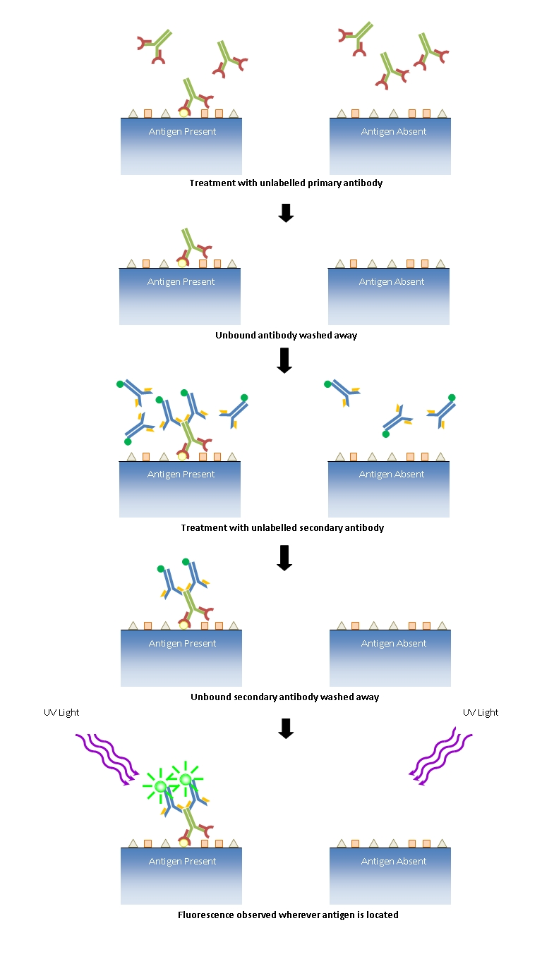
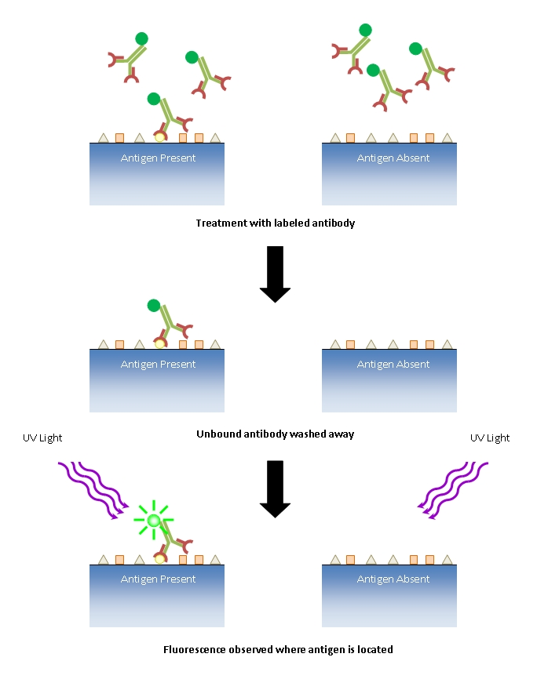
Immunofluorescence

Slide 20
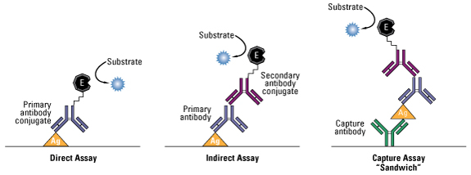
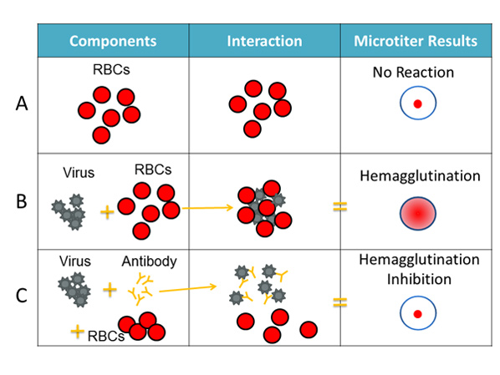
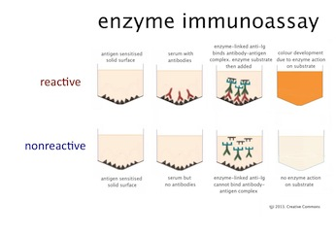
EIA, ELISA and Hemagglutination

Slide 21
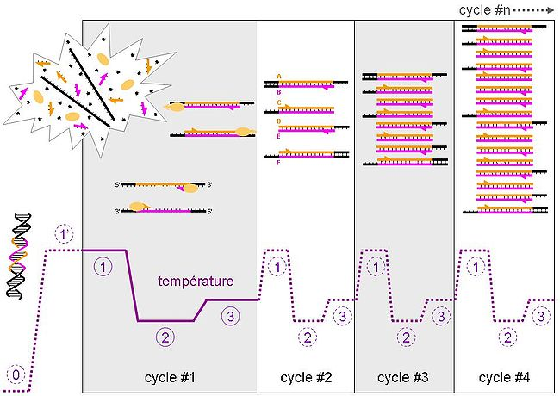
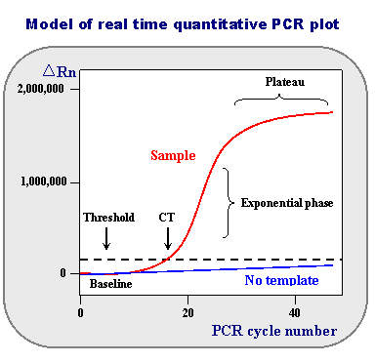
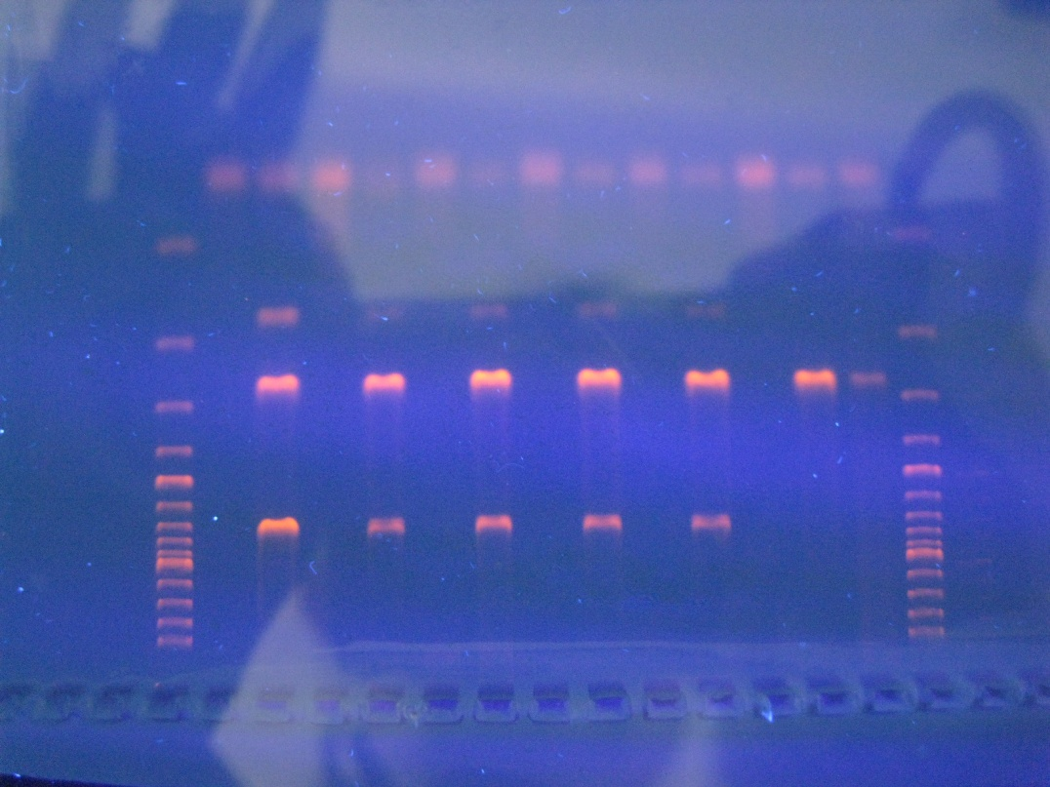
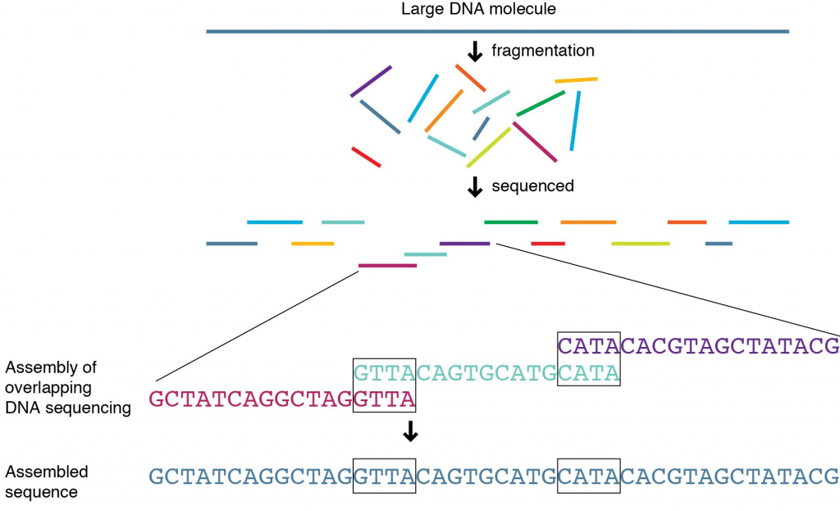
Genome sequencing, PCR and RT-PCR

Slide 22
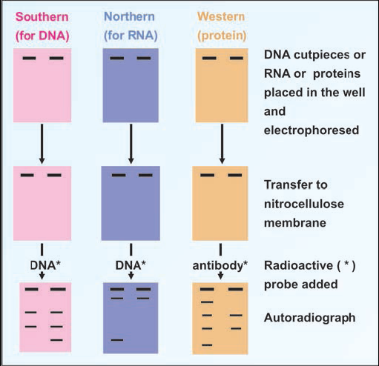
Blot test

Slide 23
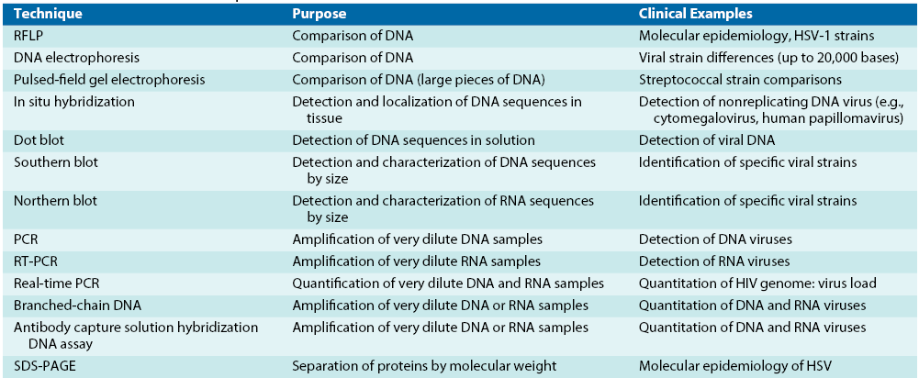
Molecular Techniques

Slide 24
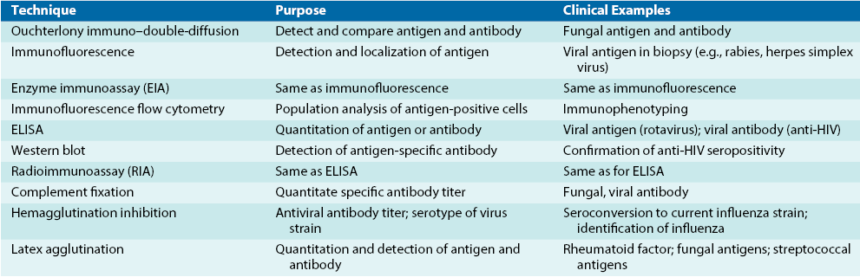
Selected Immunologic Techniques

Slide 25
Refereneces
A. Mammette «Virologie médicale» presses universitaire de lyon 2002.
JACQUELYN G. BLACK. MICROBIOLOGY 7e PRINCIPLES AND EXPLORATIONS. 2008.
Patrick R. Murray, Ken S. Rosenthal, Michael A. Pfaller. MEDICAL MICROBIOLOGY. 2013. 7th EDITION.
BRIAN W J MAHY, MARC H V VAN REGENMORTEL. Desk Encyclopedia of GENERAL VIROLOGY. 2010.
Cynthia Nau Cornelissen, Bruce D. Fisher, Richard A. Harvey, Lippincott’s Illustrated Reviews: Microbiology. Third Edition. 2013.

Slide 26
Assignment
Treatment, Prevention and Control of:
Smallpox virus
Human papillomavirus
Rotavirus
Adenovirus
Human immunodeficiency virus
Coronavirus
Rhabdovirus

